Slide 1
Chapter 15
Monopoly and Antitrust Policy
Notes:
Welcome to Economics!
Does this work?

Slide 2
Monopoly A firm that is the only seller of a good or service that does not have a close substitute.

Slide 3
To have a monopoly, barriers to entering the market must be so high that no other firms can enter.
Barriers to entry may be high enough to keep out competing firms for four main reasons:
A government blocks the entry of more than one firm into a market.
Patents, copyrights
Public Franchise A government designation that a firm is the only legal provider of a good or service.
2. One firm has control of a key resource necessary to produce a good.

Slide 4
3. There are important network externalities in supplying the good or service.
Network Externality A situation in which the usefulness of a product increases with the number of consumers who use it.
4. Economies of scale are so large that one firm has a natural monopoly.
Natural Monopoly A situation in which economies of scale are so large that one firm can supply the entire market at a lower average total cost than can two or more firms.

Slide 5
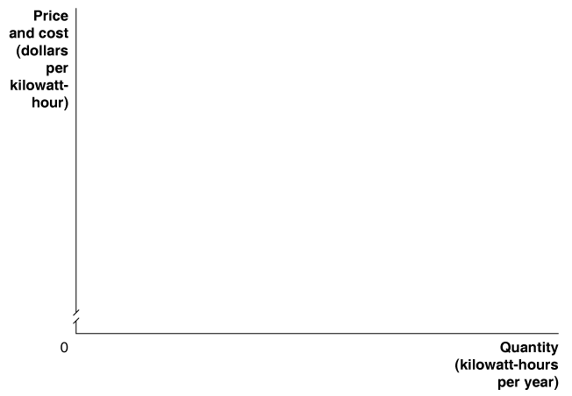
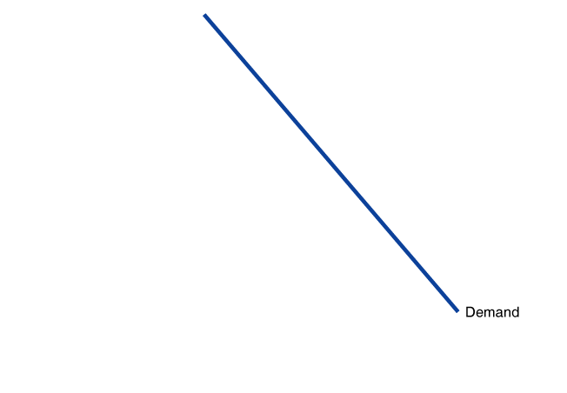
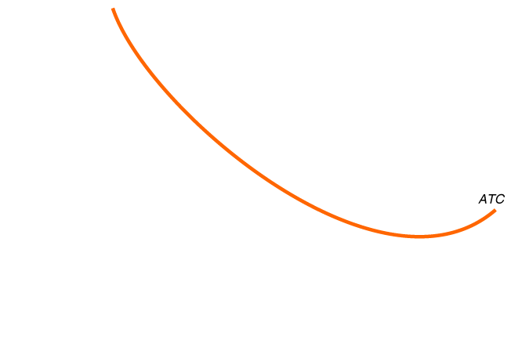
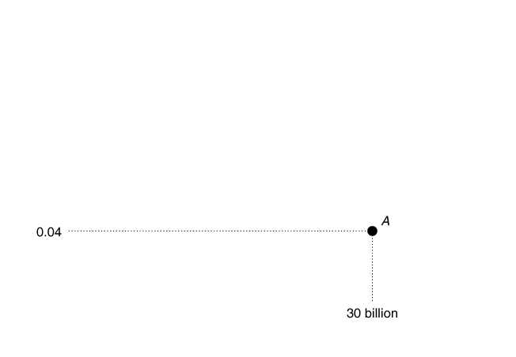
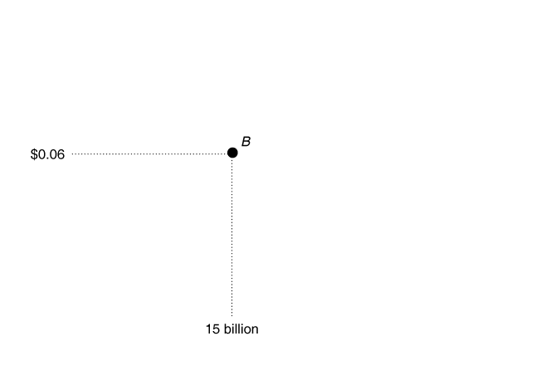
Natural Monopoly
Average Total Cost Curve for a Natural Monopoly

Slide 6
Profit Maximization in Monopoly
Price
MC
ATC
Demand
MR
Quantity

Slide 7
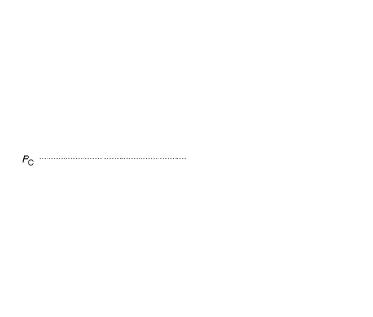
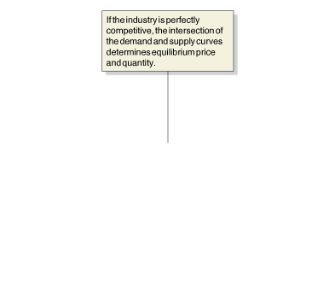
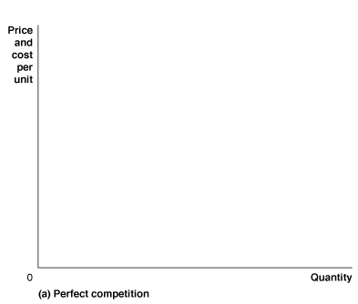
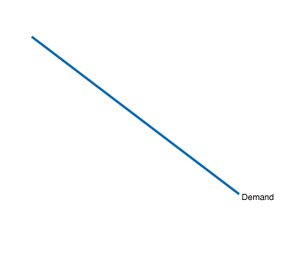
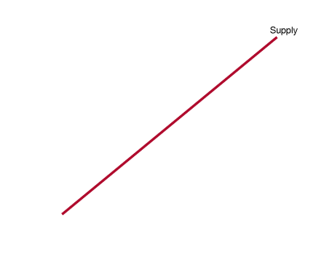
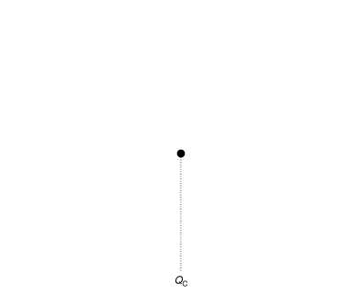
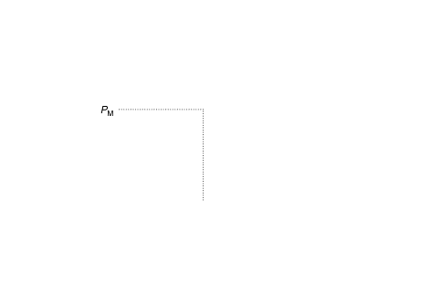
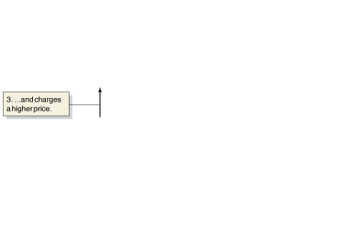
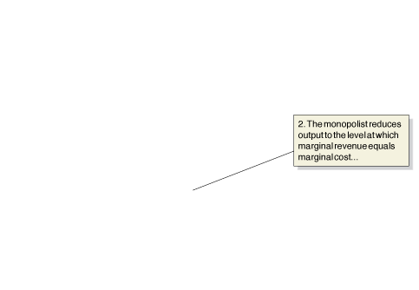
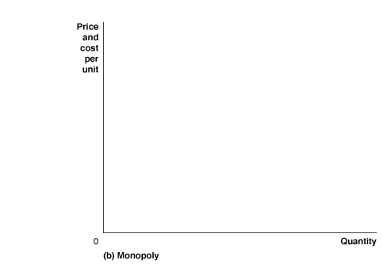
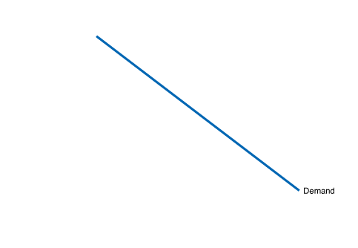
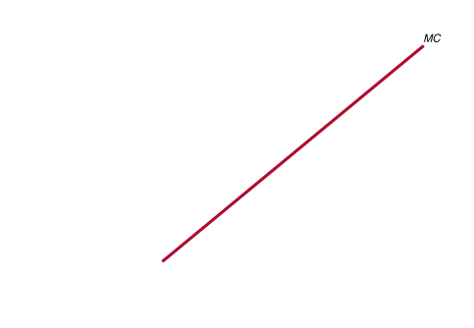
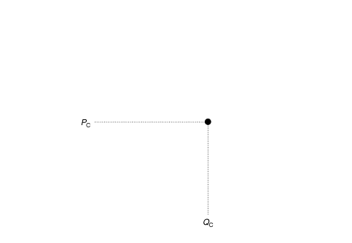
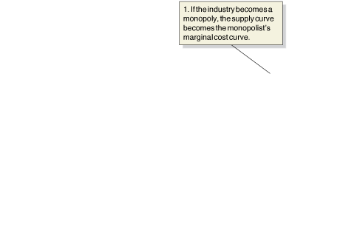
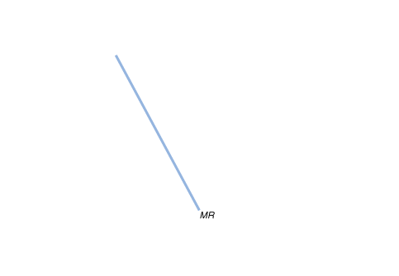
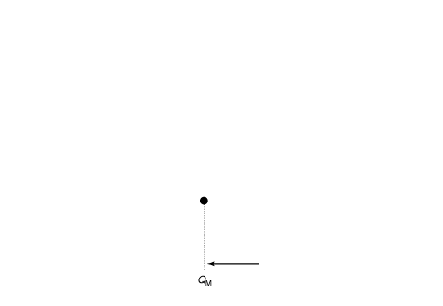
Comparing Monopoly and Perfect Competition
What Happens If a Perfectly Competitive Industry Becomes a Monopoly?

Slide 8
Economic Efficiency if the Industry is Perfectly Competitive
Price
Supply
Demand
Quantity

Slide 9
Economic Efficiency if the Industry is a Monopoly
Price
MC
Demand
Quantity

Slide 10
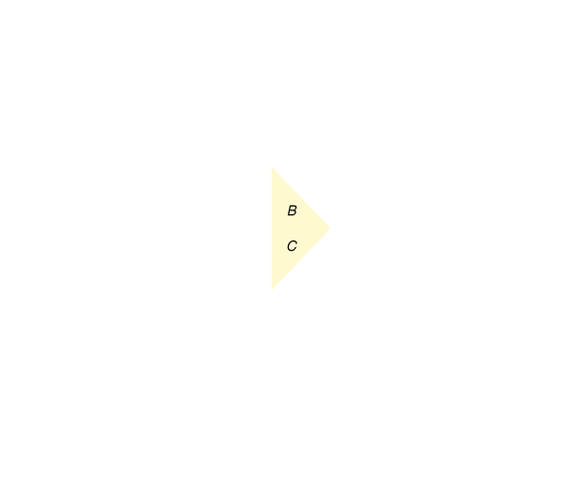
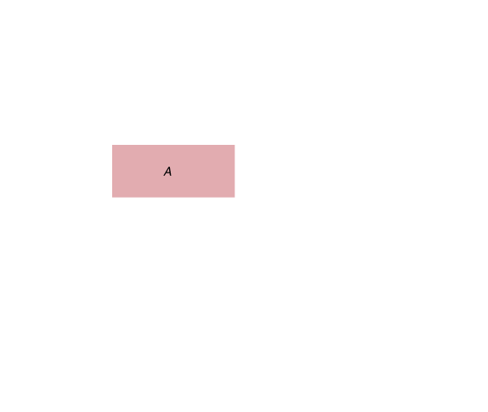
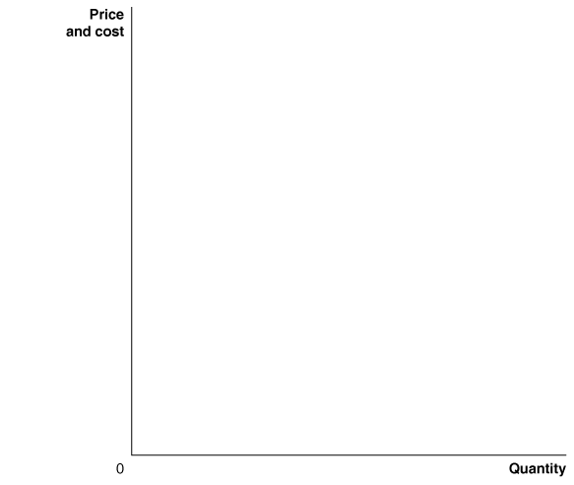
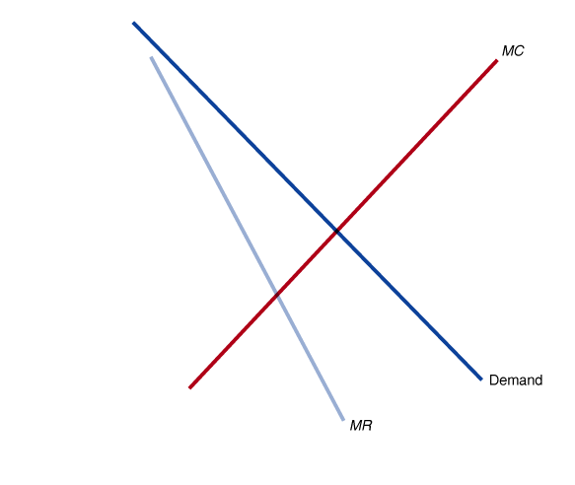
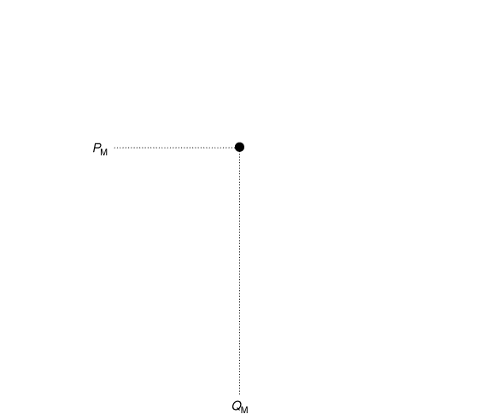
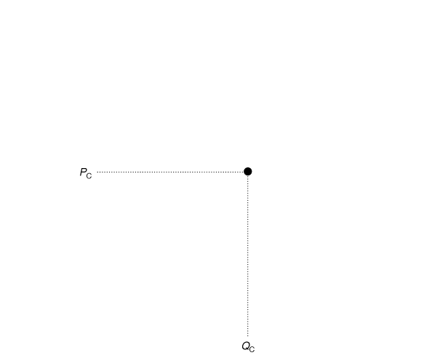
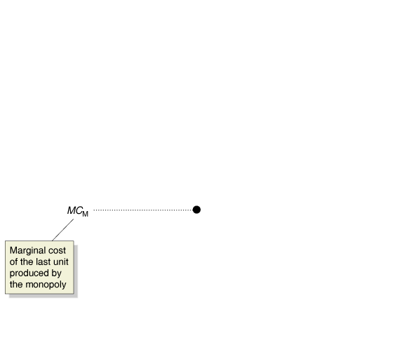
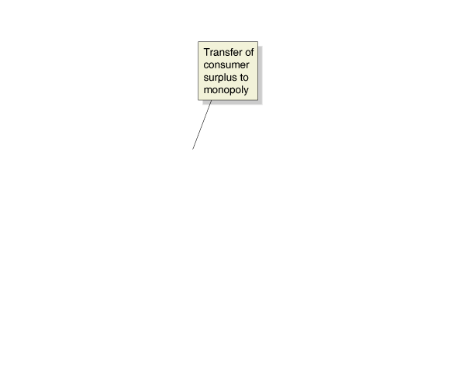
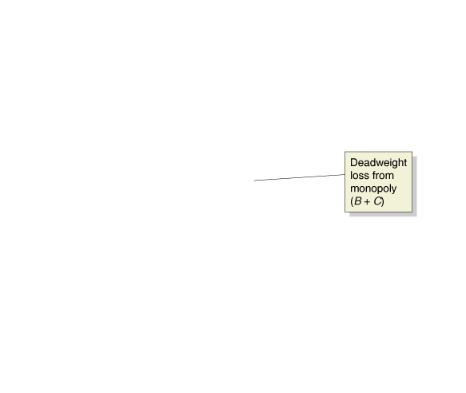
Measuring the Efficiency Losses from Monopoly
The Inefficiency of Monopoly

Slide 11
A (Partial) Defense of Monopoly
Market Power and Technological Change
The introduction of new products requires firms to spend funds on research and development.
Because firms with market power are more likely to earn economic profits than are perfectly competitive firms, they are also more likely to carry out research and development and introduce new products.
The Dynamic View of Monopoly focuses on why monopolies exist in the first place. Often it is the case that the monopoly was innovative in an important and unique way and thus has increased welfare.
Without the monopoly:
With the monopoly:

Slide 12
Mergers: The Trade-off between Market Power and Efficiency
Horizontal merger A merger between firms in the same industry.
What does the merger do to the market power of the firm?
Is it possible that the new, larger firm is more efficient (in terms of product costs) than the smaller firms were?

Slide 13
A Merger That Makes Consumers Better Off
Price
MC (Before Merger)
Demand
Quantity

